Slide 1

Co C++ ma do zaoferowania branży embedded?
Mateusz Przybyła

Slide 2
Kod pisze się łatwo,
ale czyta się trudno.

Slide 3

Co z C++ NIE jest potrzebne w branży embedded?

Slide 4
Wyjątki
void download_fw() {
// ...
throw "error while downloading fw";
}
try {
}
download_fw();​
decompress_fw();​
swap_fw();
catch ( const char * error ) {​
log_error( error );​
}
void decompress_fw() {​
// ...​
throw "error while decompressing fw";​
}
void swap_fw() {​
// ...​
throw "error while swapping fw";​
}
Zakładają wspólną obsługę błędu
Z kodu nie wynika co może pójść nie tak
-fno-exceptions
Wymagają dodatkowej sekcji w pliku binarnym
-fno-unwind-tables

Slide 5
Dziedziczenie
struct frame_header {
uint8_t frame_id;
uint64_t timestamp_ms;
};
Pomieszane style
struct device_info {​
uint32_t device_id;​
enum : uint8_t { NEW, OLD } device_variant;​
};
Niejasne intencje
Działanie relacji "is-a"
struct status_frame : frame_header, device_info {​
enum : uint8_t { OK, BAD, SO_SO } status;​
};
struct fw_version_frame : frame_header, device_info {​
uint8_t major;​
uint8_t minor;​
};

Slide 6
Polimorfizm przez dziedziczenie
struct driver {
virtual ~driver() = default;
virtual void turn_on() = 0;
};
Fałszywe abstrakcje
struct led_driver : driver {​
void turn_on() override;​
};
Zaciemnianie kodu
Podwójne pośredniczenie
struct fan_driver final : driver {​
void turn_on() final;​
};
Niestandardowy layout
​led_driver led{};​
fan_driver fan{};​
​ driver* drivers[] = { &led, &fan };​
for ( driver* d : drivers ) {​
d->turn_on();​
}

Slide 7

RTTI – Run Time Type Information
typeid( *drivers[0] ).name()
if ( auto led = dynamic_cast<led_driver*>( drivers[0] ) ) {
led->blink_on();
}
-fno-rtti

Slide 8
Biblioteka standardowa
std::cout << "Oh no...";
std::vector<uint8_t> bytes{};
std::string device_name{};
std::map<uint32_t, std::string> dev_id_to_names{};
std::shared_ptr<uint64_t> timestamp_ms{};
-nostdlib

Slide 9

Co z C++ przydaje
się w branży embedded?

Slide 10
Wygodna składnia

Slide 11
Aliasy
using size = unsigned long int;
using u8 = unsigned char;
using i8 = signed char;
using u16 = unsigned short int;
using i16 = signed short int;
using u32 = unsigned int;
using i32 = signed int;
using u64 = unsigned long int;
using i64 = signed long int;
using f32 = float;
using f64 = double;
using error_handler = i32( * )( i32 code );
vs
typedef i32( *error_handler )( i32 code );
using byte_array = u8[1024];
vs
typedef u8 byte_array[1024];

Slide 12
Definiowanie złożonych obiektów
void turn_on( led_type type )
void turn_on( enum led_type type )
enum led_type { POWER, ERROR, CUSTOM };
vs
typedef enum led_type { POWER, ERROR, CUSTOM } led_type;
union u32_bytes {
u32 value;
u8 bytes[4];
};
union u32_bytes {
u32 value;
u8 bytes[4];
};
typedef union u32_bytes u32_bytes;
vs

Slide 13
Zmienne inline
W pliku nagłówkowym:
inline const i32 i32_min = -2'147'483'648;
inline const i32 i32_max = 2'147'483'647;
inline const u32 u32_max = 0xFF'FF'FF'FF;
vs
W pliku nagłówkowym:
W pliku źródłowym:
extern const i32 i32_min;
extern const i32 i32_max;
extern const u32 u32_max;
const i32 i32_min = -2'147'483'648;
const i32 i32_max = 2'147'483'647;
const u32 u32_max = 0xFF'FF'FF'FF;

Slide 14
Range-based for loop
const size samples_count = 16;
f32 samples_history[samples_count] = { /* ... */ };
f32 mean_value = 0.0f;
for ( const f32 sample : samples_history ) {​
mean_value += sample;​
}​
mean_value /= samples_count;
for ( const char c : "WelcomeToZomboCom" ) {
uart_send( c );
}

Slide 15
Szablony
template <class T, size N>
T sum_all( T ( &array )[N] ) {​
}
T sum = 0;​​
for ( const T element : array ) {​​
sum += element;​​
}​​
return sum;​
const size samples_count = 16;
f32 samples_history[samples_count] = { /* ... */ };
const f32 mean_value = sum_all( samples_history ) / samples_count;

Slide 16
Structured binding
struct power_state {
u32 voltage_mV;
u32 current_uA;
bool power_connected;
};
power_state read_power_state();
const auto [voltage_mV, current_uA, plugged] = read_power_state();

Slide 17
Constexpr

Slide 18
enum led_type { POWER, ERROR, CUSTOM };
const char * led_name( led_type led )
constexpr
{​
switch ( led ) {​
case POWER: return "Power LED";​
case ERROR: return "Error LED";​
case CUSTOM: return "Custom LED";​
}​
return nullptr;​
}
const char* name = led_name( POWER );
constexpr
static_assert( name != nullptr );
static_assert( name == "Power LED" );

Slide 19
constexpr u32 factorial( u32 n ) {
return ( n < 2 ) ? 1 : n * factorial( n - 1 );
}
constexpr u32 binomial( u32 n, u32 k ) {
return factorial( n ) / ( factorial( k ) * factorial( n - k ) );
}
template <size N>
struct array {
u32 data[N];
};
template <size N>
constexpr array<N + 1> binomial_coeffs()
{​
array<N + 1> coeffs;
for ( size k = 0; k < N / 2 + 1; ++k ) {
coeffs[k] = coeffs[N - k] = binomial( N, k );
}
return coeffs;
}
constexpr auto coefficients = binomial_coeffs<12>();
// 1 12 66 220 495 792 924 792 495 220 66 12 1

Slide 20
f32 raw_acc_to_g( i16 raw_acc ) {
constexpr f32 acc_scale = 157.5f;
return raw_acc / acc_scale;
}
#define ACC_SCALE 157.5f
f32 raw_acc_to_g( i16 raw_acc ) {
return raw_acc / ACC_SCALE;
}
vs
void read_git_hash() {
const u32 bytes_count = 40;
u8 bytes[bytes_count];
// ...
}
void read_git_hash() {
constexpr u32 bytes_count = 40;
u8 bytes[bytes_count] = {};
// ...
}
!
vs

Slide 21
Consteval

Slide 22
template <class T, size N>
struct array {
T data[N];
};
constexpr T& operator[]( size idx ) { ​
return data[idx]; ​
}
static_assert( idx < N );

Slide 23
template <class T, size N>
struct array {
T data[N];
constexpr T& operator[]( size idx )
{
return data[idx];
}
};
static void index_out_of_bounds() {}
if consteval {​
​
}
if ( idx >= N ) {​​
index_out_of_bounds();​​
}​

Slide 24
constexpr void assert( bool condition ) {
}
if consteval {​
compile_time_assert( condition );​
}
else {​
run_time_assert( condition );​
}
void run_time_assert( bool condition ) {
if ( !condition ) {
*( int volatile * )( 0 ) = 0;
}
}
constexpr
void compile_time_assert( bool condition ) {
if ( !condition ) {
run_time_assert( condition );
}
}
constexpr T& operator[]( size idx ) {
assert( idx < N );
return data[idx];
}

Slide 25
Enkapsulacja

Slide 26
const i32 press_time = get_press_duration();
Jaką to ma jednostkę?

Slide 27
class duration {
};
duration( i32 milliseconds ) : milliseconds_{ milliseconds } {}
static constexpr i32 s_to_ms = 1000;​
i32 milliseconds_;
public:​
static duration from_seconds( i32 s ) { return duration{ s * s_to_ms }; }​
static duration from_milliseconds( i32 ms ) { return duration{ ms }; }​
i32 as_seconds() const { return milliseconds_ / s_to_ms; }​
i32 as_milliseconds() const { return milliseconds_; }
const duration press_time = get_press_duration();​
if ( press_time.as_milliseconds() > 500 ) {
// ...
}

Slide 28
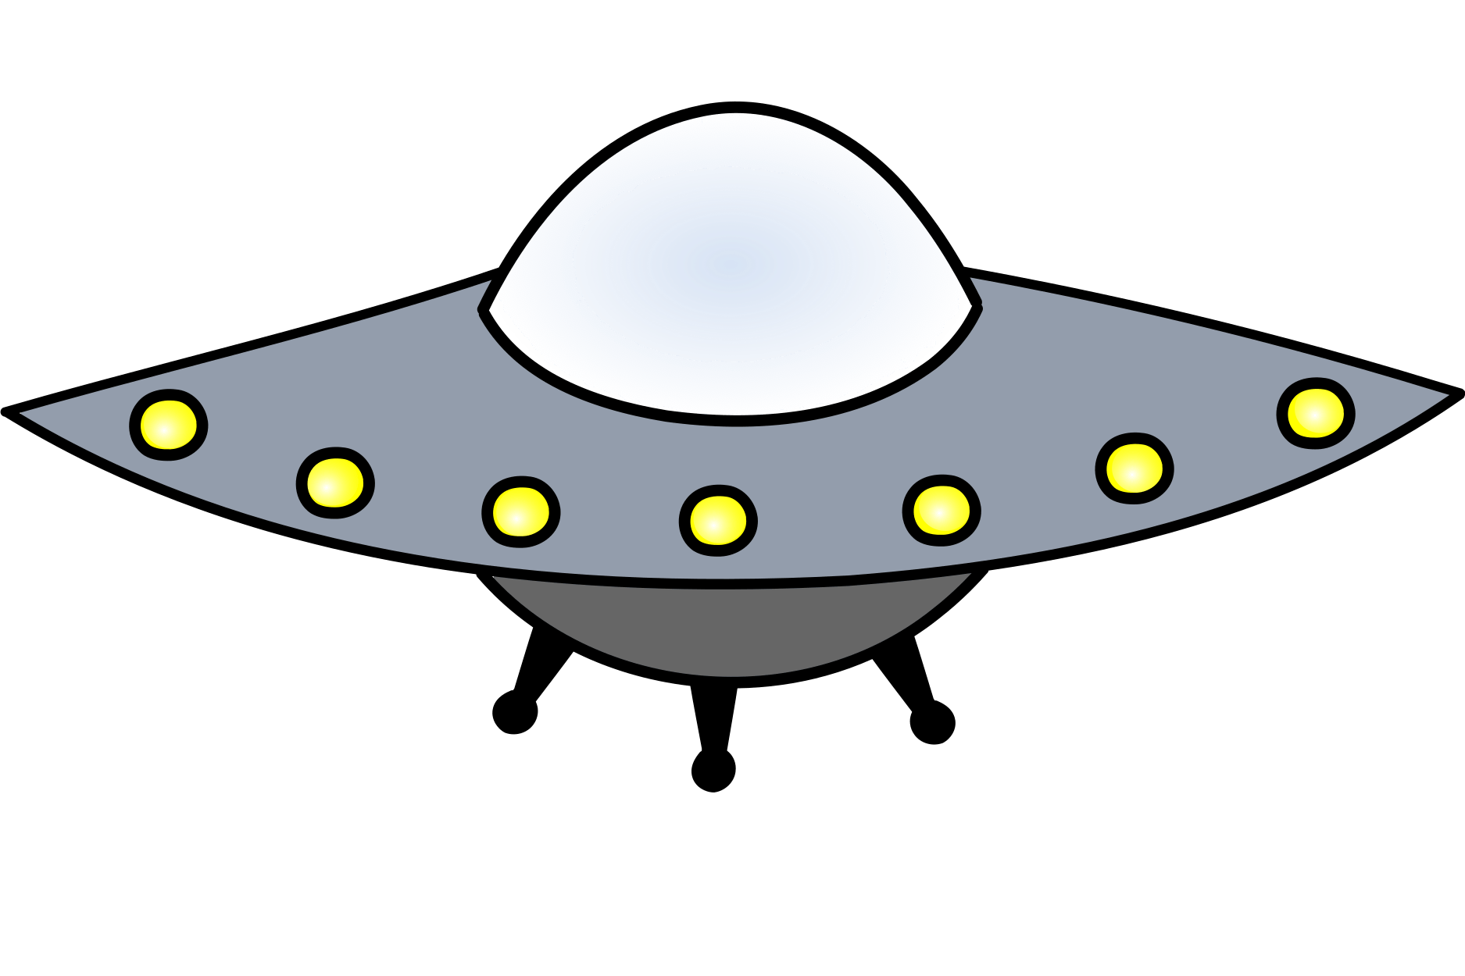
Przeciążanie operatorów
class voltage {
voltage( i32 millivolts ) : millivolts_{ millivolts } {}
i32 millivolts_;
public:
// ...
};
i32 operator<=>( voltage other ) const {​
return millivolts_ - other.millivolts_;​
}
bool operator==( voltage other ) const {
return millivolts_ == other.millivolts_;
}
const voltage vcc = read_vcc();
if ( vcc < voltage::from_volts( 5 ) ) {
// ...
}

Slide 29
const u32 distance = measure_distance();​
if ( distance != u32_max ) {
// ...
}

Slide 30
class distance {
};
distance() = default;​
// ...
static constexpr u32 invalid_distance = u32_max;
u32 millimeters_{ invalid_distance };​
public:
static distance invalid() { return distance{}; } ​
// ...
bool is_valid() const { return millimeters_ != invalid_distance; }
const distance d = read_distance();
if ( d.is_valid() ) {
// ...
}

Slide 31
Memory-mapped devices

Slide 32
Jak włączyć SPI?
Rejestry SPI
SPI_CR1 (0xAB00)
SPI_CR2 (0xAB02)
SPI_SR (0xAB04)
SPI_DR (0xAB06)
...
*
( u16 * )( )
0xAB'00
|= ( 1 << 6 );
constexpr u32 SPI_CR1_ADDR = 0xAB'00;
*( u16 * )( SPI_CR1_ADDR ) |= ( 1 << 6 );
using dev_reg = volatile u16;
constexpr u32 SPI_CR1_ADDR = 0xAB'00;
*( dev_reg * )( SPI_CR1_ADDR ) |= ( 1 << 6 );
A może lepiej:
spi.enable()
?

Slide 33
using dev_reg = volatile u16;
struct spi_registers {
dev_reg control_1;
dev_reg control_2;
dev_reg const status;
dev_reg data;
// ...
};
Rejestry SPI
SPI_CR1 (0xAB00)
SPI_CR2 (0xAB02)
SPI_SR (0xAB04)
SPI_DR (0xAB06)
...
Uwaga: padding!
constexpr u32 SPI_CR1_ADDR = 0xAB'00;
spi_registers & spi = *( spi_registers * )( SPI_CR1_ADDR );
spi.control_1 |= ( 1 << 6 );

Slide 34
class spi_registers {
dev_reg control_1;
dev_reg control_2;
dev_reg const status;
dev_reg data;
// ...
public:
void enable() { control_1 |= ( 1 << 6 ); }
};
constexpr u32 SPI_CR1_ADDR = 0xAB'00;
spi_registers & spi = *( spi_registers * )( SPI_CR1_ADDR );
spi.enable();

Slide 35
struct spi_registers {
dev_reg control_1;
dev_reg control_2;
dev_reg const status;
dev_reg data_reg;
// ...
};
class spi_controller {
};
static constexpr u32 regs_offset = 0xAB'00;​
​ spi_registers & regs_;
public:​
spi_controller() : ​
regs_{ *( spi_registers * )( regs_offset ) } {}
void enable() { regs_.control_1 |= ( 1 << 6 ); }​
spi_controller spi{};
spi.enable();

Slide 36
class spi_controller {
};
struct spi_registers {​
// ...​
};
static constexpr u32 regs_offset = 0xAB'00;​
​ spi_registers & regs_;
public:​
spi_controller() : regs_{ *( spi_registers * )( regs_offset ) } {}​
​ void enable() { regs_.control_1 |= ( 1 << 6 ); }​
// ...

Slide 37
class spi_controller {
};
struct spi_registers {​
dev_reg control_1{ 0x0040 };​
dev_reg control_2{ 0x0A0B };​
dev_reg const status{};​
dev_reg data_reg{};​
// ...​
};
static constexpr u32 regs_offset = 0xAB'00;​
​ spi_registers & regs_;
public:​
spi_controller() : regs_{ *new( ( void * )regs_offset ) spi_registers } {}
void enable() { regs_.control_1 |= ( 1 << 6 ); }​
// ...

Slide 38
Destruktor

Slide 39
void upgrade_fw()
{
}
blink_custom_led();
if ( download_fw() < 0 ) {​
turn_off_led();​
return;​
}
if ( decompress_fw() < 0 ) {​
turn_off_led();​
return;​
}
if ( swap_fw() < 0 ) {​
turn_off_led();​
return;​
}

Slide 40
void upgrade_fw()
{
blink_custom_led();
}
template <class F>
class on_scope_exit {
};
F action_;
on_scope_exit led_guard{ turn_off_led };
public:​
on_scope_exit( F action ) : ​
action_{ action } {}
if ( download_fw() < 0 ) {​
return;​
}​
​ if ( decompress_fw() < 0 ) {​
return;​
}​
​ if ( swap_fw() < 0 ) {​
return;​
}
~on_scope_exit() { action_(); }

Slide 41
{
on_scope_exit scope_guard{ [] {
turn_off_led();
reboot();
} };
// ...
}
template <class F>
class on_scope_exit {
};
F action_;
public:​
on_scope_exit( F action ) : ​
action_{ action } {}
~on_scope_exit() { action_(); }
{
int result{};
on_scope_exit scope_guard{ [&result] {
turn_off_led();
send_result( result );
reboot();
} };
// ...
}

Slide 42
Co dalej?

Slide 43
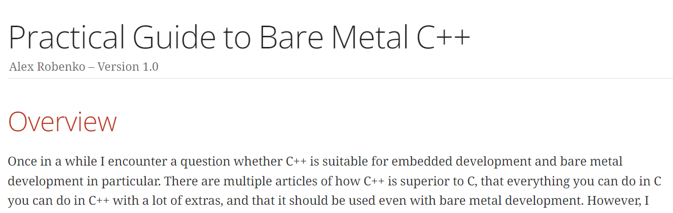
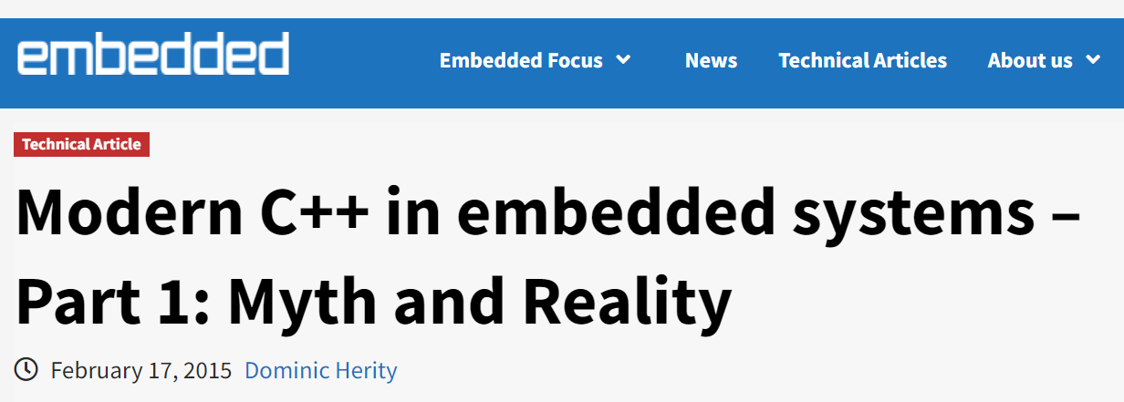
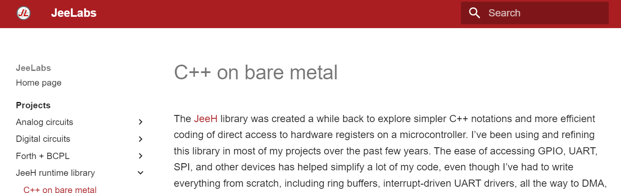
Warto poczytać

Slide 44
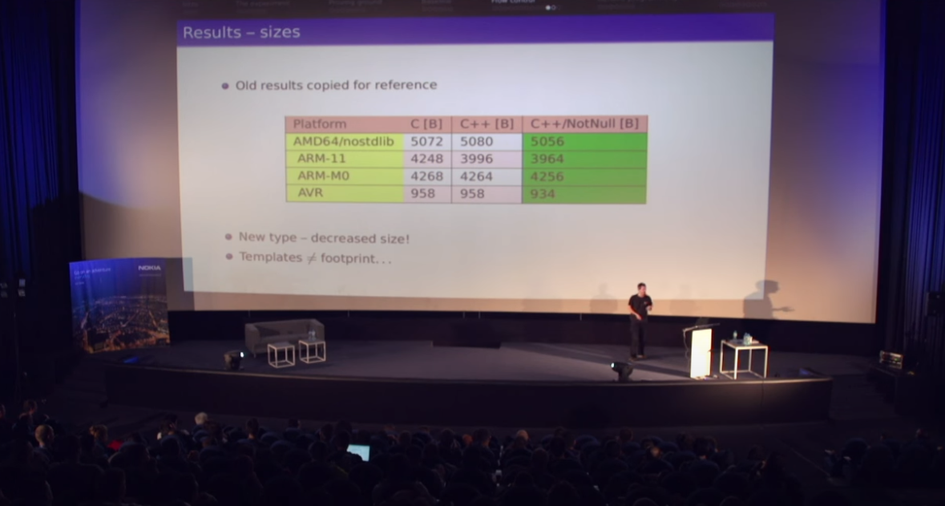
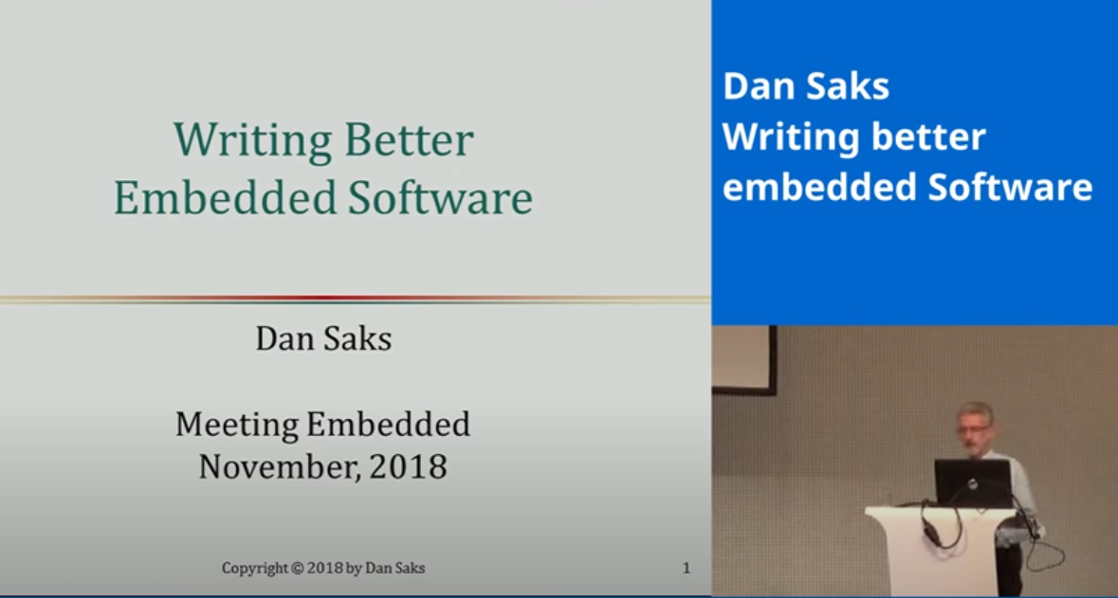
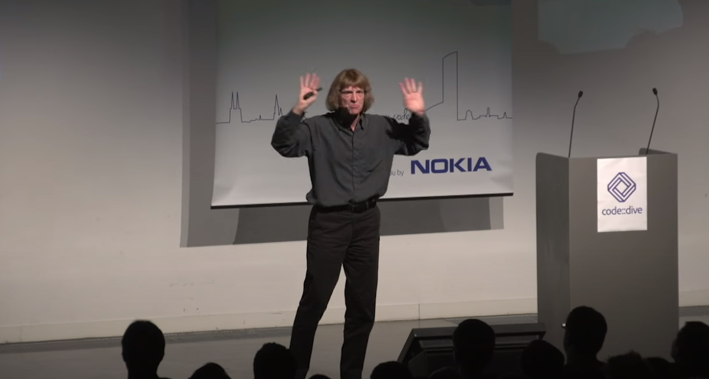
Warto obejrzeć
code::dive conference 2015
Bartosz Szurgot
C++ vs C the embedded perspective
Meeting Embedded 2018
Dan Saks
Keynote - Writing better embedded Software
code::dive conference 2014
Scott Meyers
Support for Embedded Programming in C++11 and C++14

Slide 45
Kod pisze się łatwo,
ale czyta się trudno.

Slide 46
Pisz kod, który przyszły
ty chciałby czytać.

Slide 47

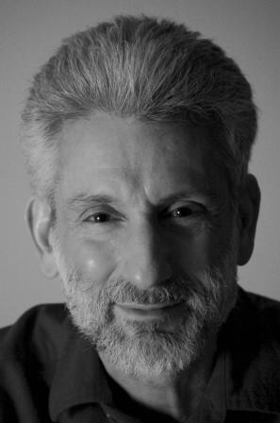
Make interfaces easy to use correctly and hard to use incorrectly.
- Scott Meyers
Program in a style that turns potential run-time errors into compile-time errors.
- Dan Saks

Slide 48
Dziękuję za uwagę

